Slide 1
Fall Detection
Alexander Pugh, Andrew Page, Nicholas Gabrisko
April 2019

Slide 2
Introduction
On average, an elderly person dies every 19 minutes from an injury related to a fall [1]
Current fall prevention has imperfections [2]
Goal is to use data gathered to improve fall detection confidence

Slide 3
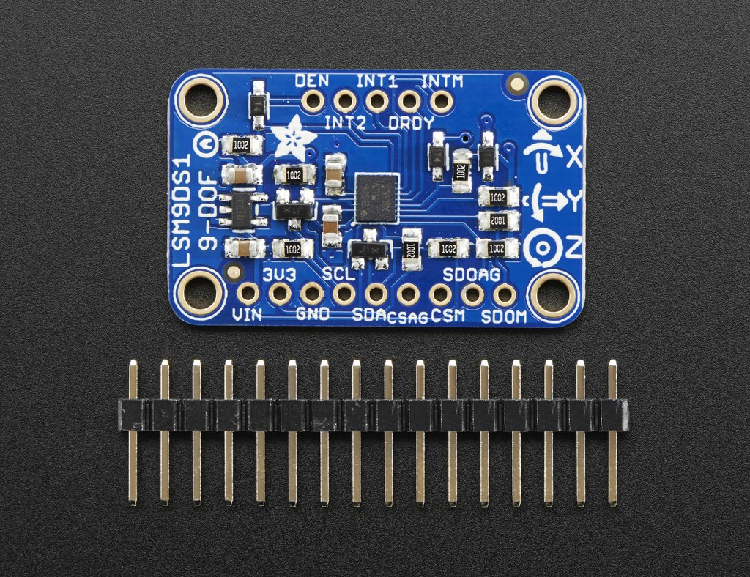
Equipment
Arduino Mega 2560 microcontroller; LSM9DS1 9-axis. [3]
TCA9548 I2C Multiplexer
Photo from Adafruit

Slide 4
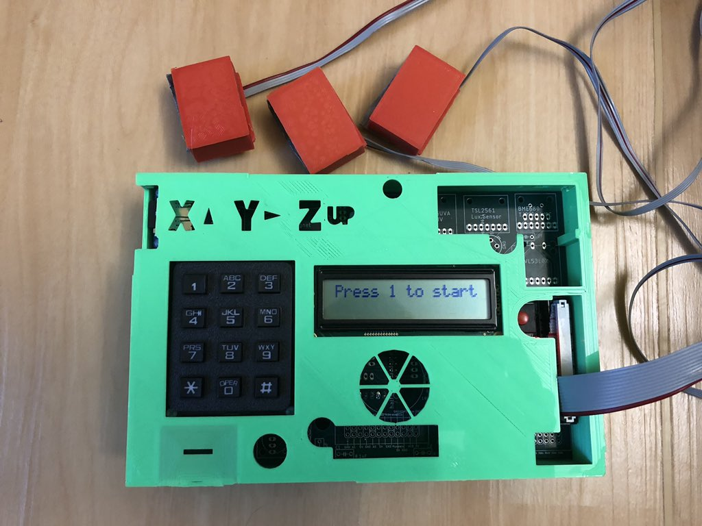
Equipment
Components connected utilizing printed circuit board
3D cases
Ribbon cables

Slide 5
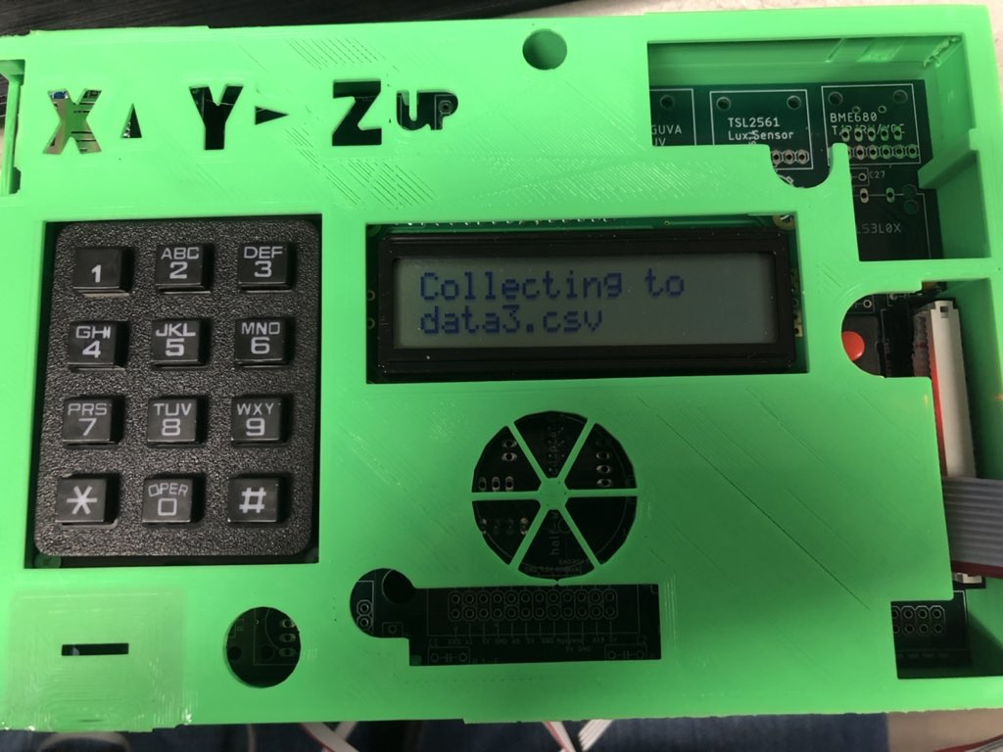
Data Acquisition
Emphasized ease of use
Gave visual feedback via LCD
Keypad controlled
Utilized “Mode” structure

Slide 6
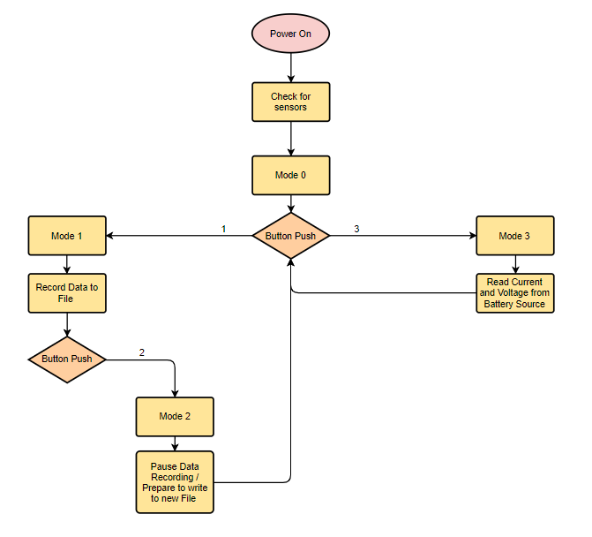

Slide 7
Experiment
Used accelerometers to take data of everyday activities
Used mannequin to model specific category of fall
Took video footage for each trial

Slide 8
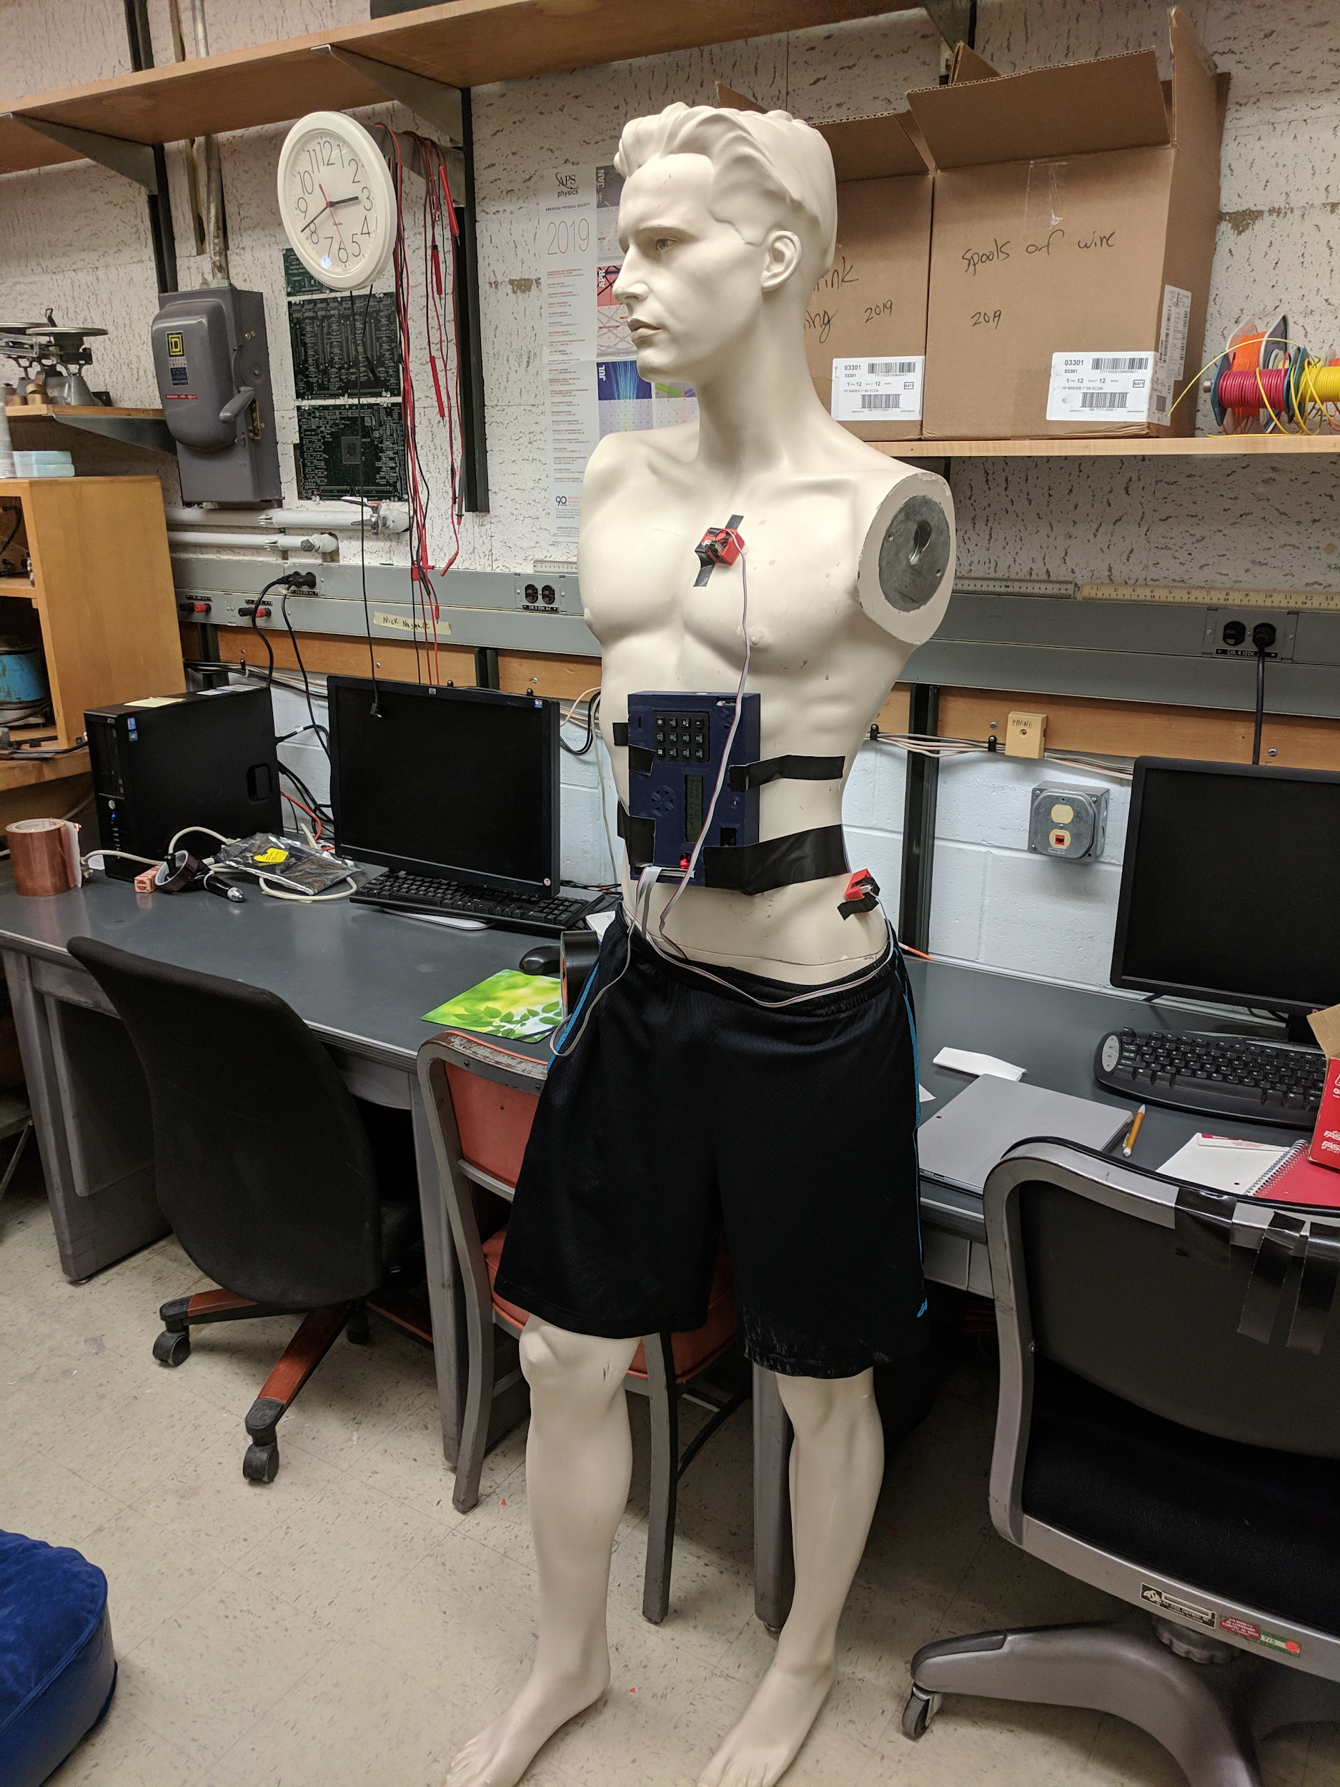

Slide 9
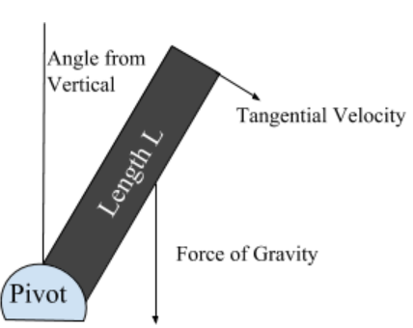
Offline Analysis
Graphed values from ‘.csv’ files
Interested in magnitude of acceleration
Calculated accumulated error compared to model

Slide 10
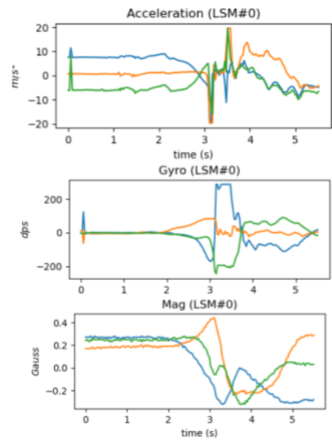
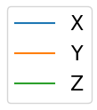
Results and Analysis
The LSM9DS1’s gather three types of data:
Acceleration
Rotation Rate
Magnetic Field Strength
Each of these can be used for different aspects of
fall detection, but our analysis focuses on
acceleration.

Slide 11
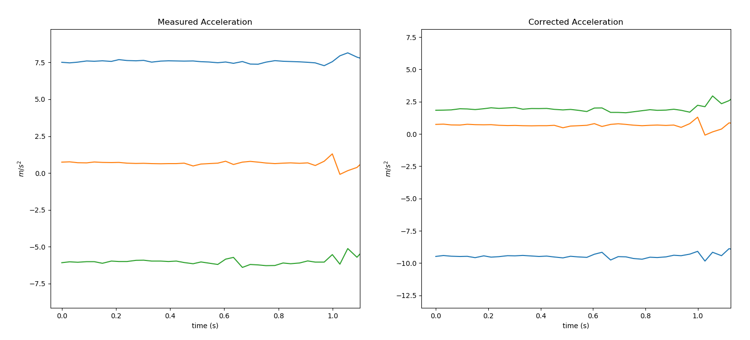
Correction
The accelerometers return values that indicate the sensor’s body axes don’t align with the lab frame’s axes. This is fixed using rotation matrices, calculated based on the sensor’s initial orientation, on each data point. Once the data is rotated, we exclude g from the magnitude of the acceleration.

Slide 12
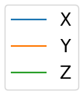
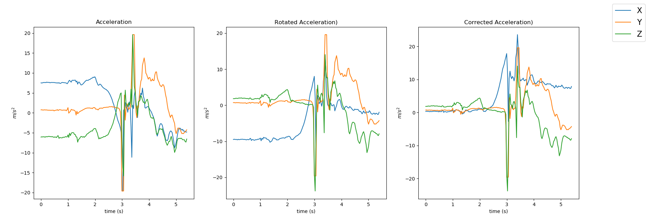
Step by Step Correction
Measured Acceleration Corrected Acceleration Lab-Frame Acceleration

Slide 13
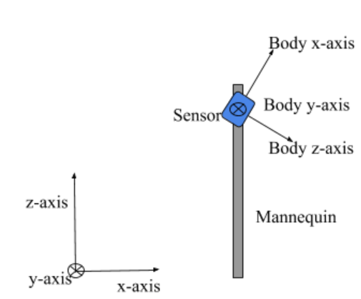
Visualized Tilt

Slide 14
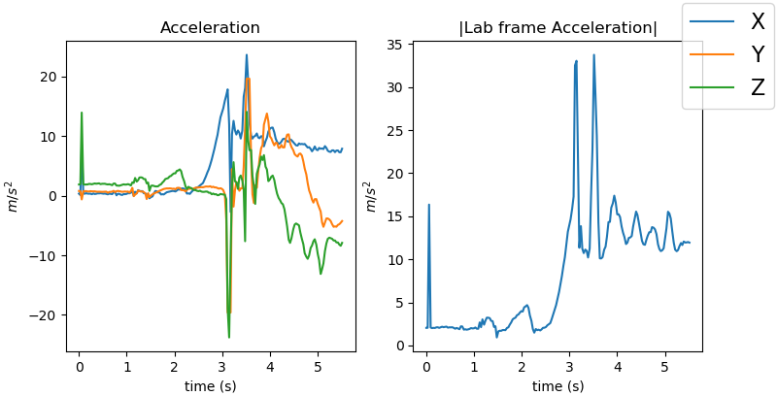
After the Correction

Slide 15
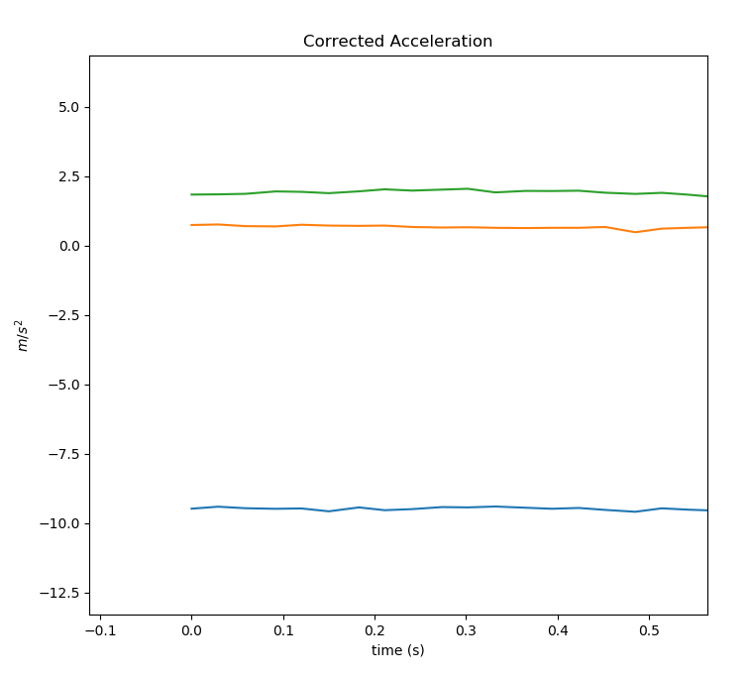
The Four Parts of a Fall: Calibration
There were four distinct events in the falls gathered.
The first one can be used for calibration. This is
where the information about the initial
orientation is automatically gathered.

Slide 16
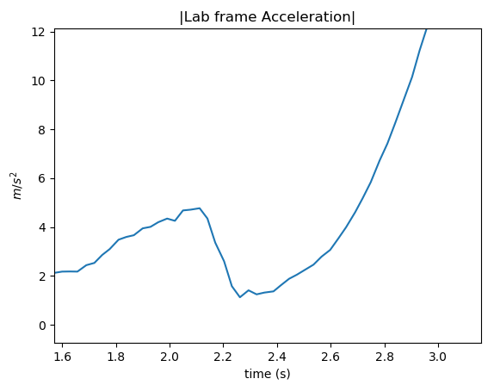
The Four Parts of a Fall: Falling
This is when the push and the fall take place.
Detecting the fall in this stage is the goal of our
Offline Analysis.
The initial spike of acceleration is from pushing the
Mannequin over.

Slide 17
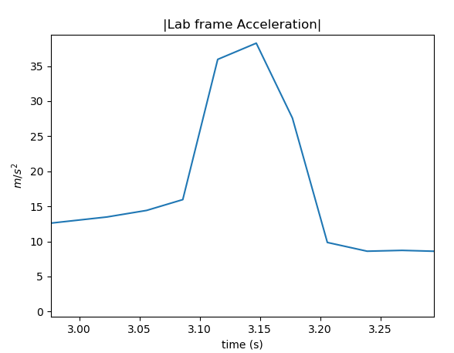
The Four Parts of a Fall: Landing
This part is the easiest to detect.
However, once the fall victim lands,
The damage is done.

Slide 18
The Four Parts of a Fall: Aftermath
In our experiment, the subject (the mannequin) bounced. This phase can be used in the same ways as the previous.

Slide 19
Discussion
Comparing to a simple physical model:
The mannequin can be approximated as a uniform rod
connected to a pivot. Through calculations similar to
those discussed in Taylor’s Classical Mechanics [7], the
magnitude of acceleration at the length r down the rod is

Slide 20
Validity of the Model
The validity of the model can be assessed by how well it conforms to the model’s assumptions.
In the videos, the mannequin’s feet are in contact with the ground throughout most of the fall.
The mannequin’s mass distribution is reasonably uniform.
In the tests, the mannequin doesn’t rotate much about the body x-axis as it falls.
The tests take place in a mostly uniform gravitational field.
Our model and experiment depict a very specific type of fall that can arise from someone tripping or fainting while standing upright.

Slide 21
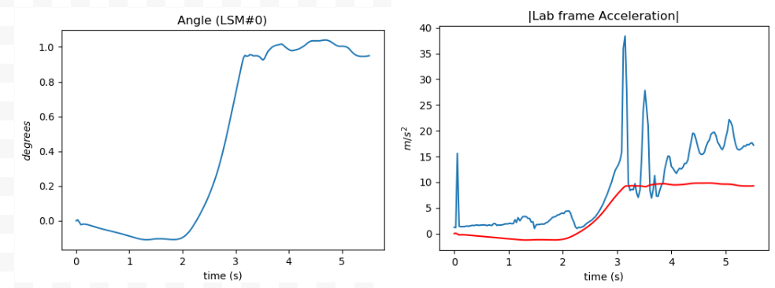
Comparing Data to the Model:
Here, the red line depicts the model’s predicted acceleration values based on the angle from the vertical.

Slide 22
Conclusions
One of the largest issues with detecting a fall is determining the relevant thresholds.
How much acceleration is too much acceleration?
If the threshold is too high, there is a heightened risk of a false negative (not detecting a fall).
If the threshold is too low, there is a heightened risk of a false positive (detecting a fall when there isn’t one)

Slide 23
Comparing Data to the Model
The detection method we used is to calculate the expected acceleration magnitude based on the gyroscope data for each time step.
This is then compared to the measured acceleration values, and the error in the prediction is accumulated.
If, for any 0.33-second time interval, the error is less than an experimentally determined threshold, a fall is registered.

Slide 24
Problems With Comparison Detection
This method is still susceptible to being fooled by false positives.
Actions such as the subject bending over to pick something up often registers falls based on this detection system.
Because of this, a network of various detection systems should be employed to detect falls instead of relying on a single method.

Slide 25
Positive Conclusions
The experiment used three accelerometers: located at the chest, hip and ankle. ‘
The results showed the same indicators in each set of data. This means that in our simple plank-falling case, the information from different accelerometers is redundant.
Because of this, a fall detection device can be made with a single accelerometer, increasing its lifetime and simplicity.

Slide 26
Possible Future Directions
Creating a network of detectors will enhance the reliability of the system.
Sensors can be both attached to the subject and scattered around their home.
Focusing on magnetometer and gyroscope data may yield additional promising results.
Other detection technologies rely on changes in hot water and wifi usage in the home. The data gathered from this is independent from accelerations in a fall, and can help detect after it has happened.

Slide 27
References
Fall Prevention Facts. Retrieved from https://www.ncoa.org/news/resources-for-reporters/get-the-facts/falls-prevention-facts/.
Broadley, R. W., Klenk, J., Thies, S. B., Kenney, L. P., & Granat, M. H. (2018, June 27). Methods for the Real-World Evaluation of Fall Detection Technology: A Scoping Review. Retrieved from https://www.ncbi.nlm.nih.gov/pmc/articles/PMC6068511/
Adafruit Industries. (n.d.). Retrieved from https://www.adafruit.com/
Collection of Falling Person (41). (n.d.). Retrieved from http://clipart-library.com/falling-person.html
110 Free vector graphics of Falling. (n.d.). Retrieved from https://pixabay.com/vectors/search/falling/
New Advances and Challenges of Fall Detection Systems: A Survey
Taylor, J. R. (2005). Classical mechanics. Sausalito, CA: University Science Books.
The K&J Magnetic Field Calculator. (n.d.). Retrieved from https://www.kjmagnetics.com/fieldcalculator.asp

